Slide 1

Week 9
Arduino programming
Fundamentals of IoT
Dr. Eoin Rogers (eoin.rogers@tudublin.ie)

Slide 2
Lesson Outline
Introducing the Arduino and how to program it
We won’t be using the Arduino directly this year, but there is one in the kits that you can play around with if you’d like (I have put up lab exercises in case you want to try them!)
Knowing how to program it might be useful for IoT FYPs and other projects (although be aware of the limitations of the Arduino!)

Slide 3
Arduino
A widely used, open-source SBC

Slide 4
What is an Arduino
An open-source single-board computer (SBC)
Powered by an 8-bit microcontroller (Atmega 328P)
Developed by a group based in Italy
Each cost about €20
Programming in a dialect of C++

Slide 5
Advantages of the Arduino
Very cheap
Huge range of models
Hugely extensible
  A family of add-on-boards to expand Arduinos – called shields – are widely used

Slide 6
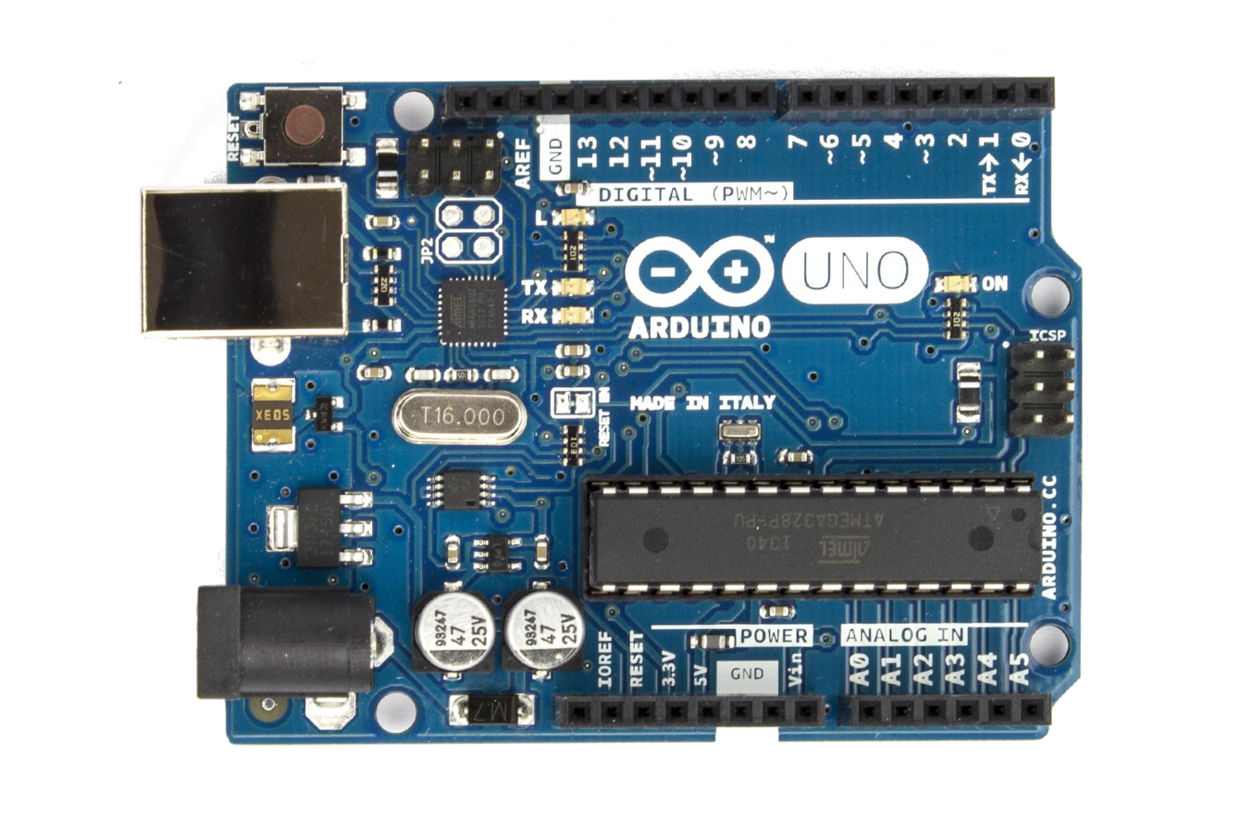
Arduino Uno

Slide 7
Arduino Uno
Microcontroller

Slide 8
Arduino Uno
Reset button

Slide 9
Arduino Uno
Power

Slide 10
Arduino Uno
Voltage regulator

Slide 11
Arduino Uno
Digital I/O

Slide 12
Arduino Uno
Peripheral power

Slide 13
Arduino Uno
Oscillator

Slide 14
Arduino Uno
Analogue input

Slide 15
Arduino Uno
AREF pin

Slide 16
Arduino Uno
LEDs

Slide 17
Programming the Arduino
There is an Arduino IDE which makes this very easy!

Slide 18
Sketches
Arduino programs are called sketches
They are typically written in a variant of C++ (basically C++ for AVR with a non-default linker script)
They are transferred to the Arduino via the USB port

Slide 19
Basic sketch
An Arduino program should have two functions:
  setup(), which contains initialisation code
  loop(), which runs continuously until the Arduino is turned off!
Unlike a typical C++ program, there is no main()

Slide 20
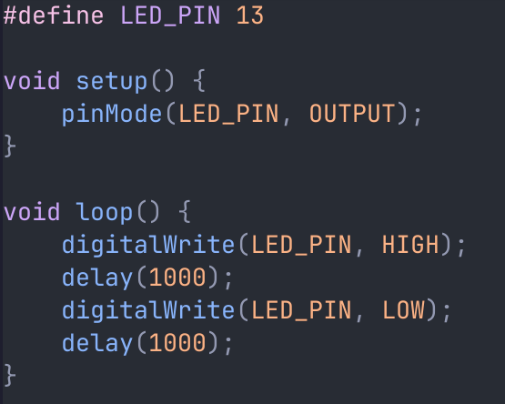
Blinking an LED

Slide 21
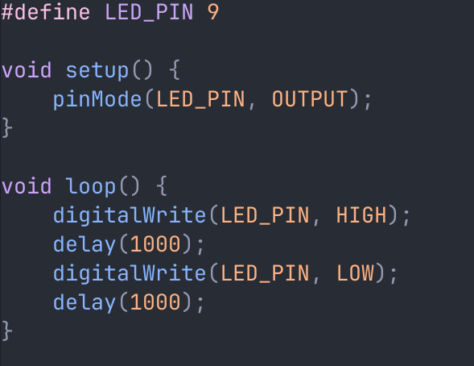
Blinking your own LED

Slide 22
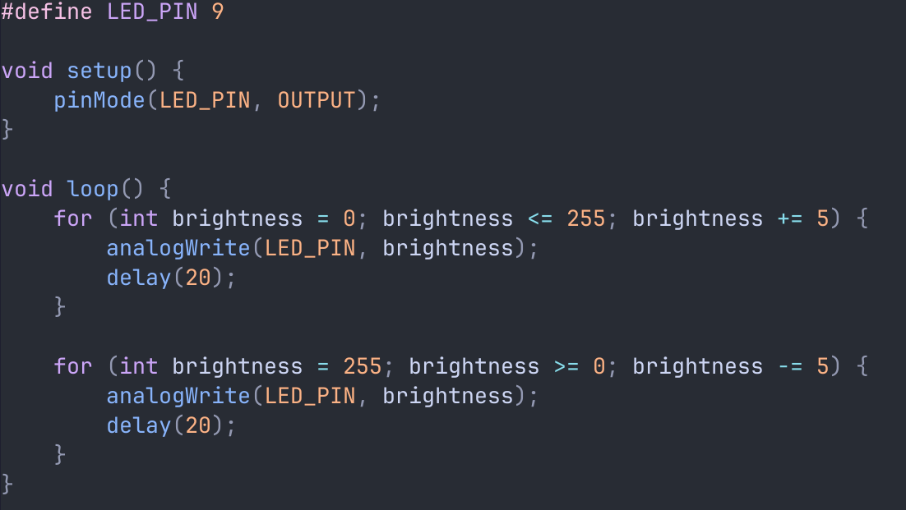
Making the LED fade in and out

Slide 23
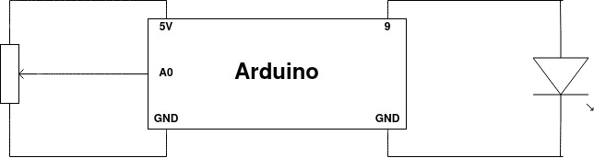
Potentiometer diagram

Slide 24
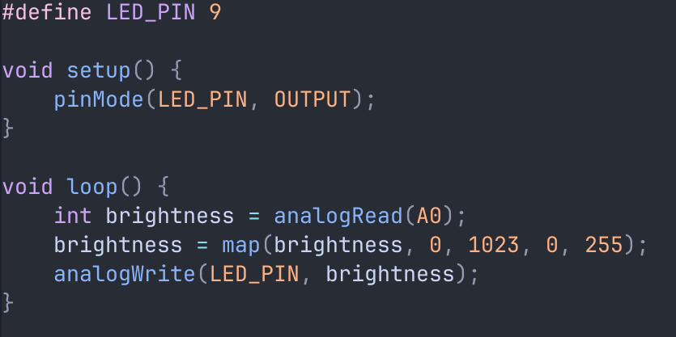
Potentiometer code

Slide 25
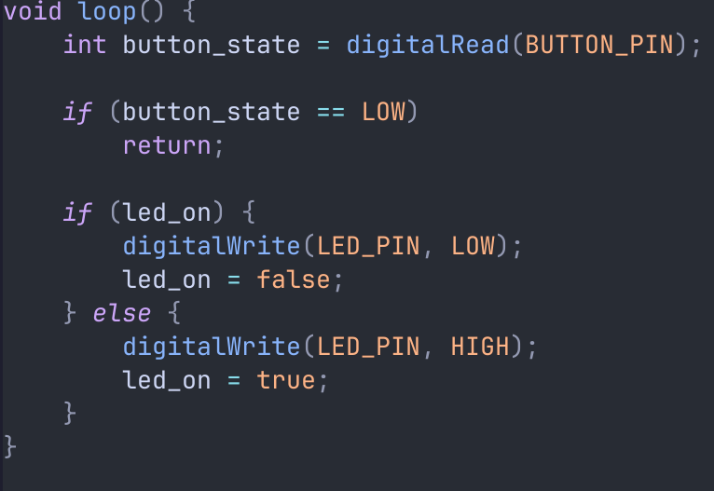
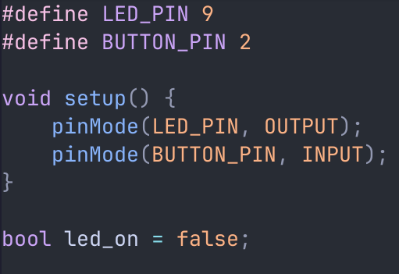
Button

Slide 26
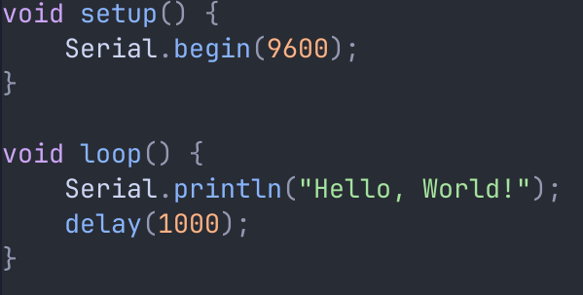
Serial monitor (useful for debugging)

Slide 27
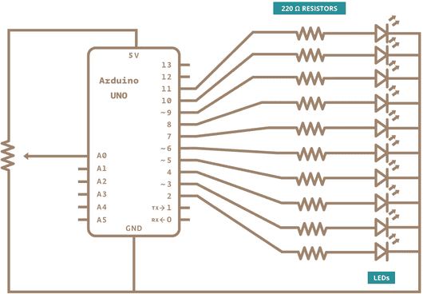
LED bar chart diagram

Slide 28
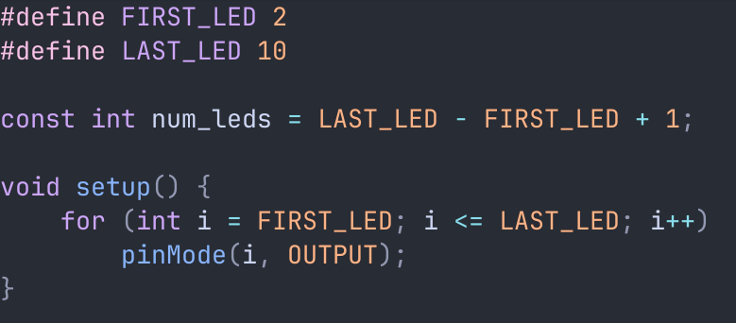
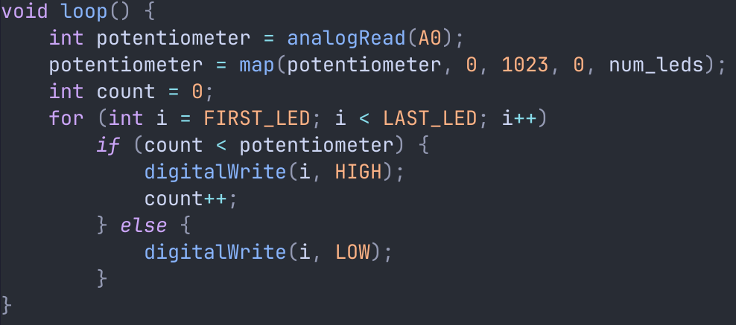
LED bar chart code

Slide 29
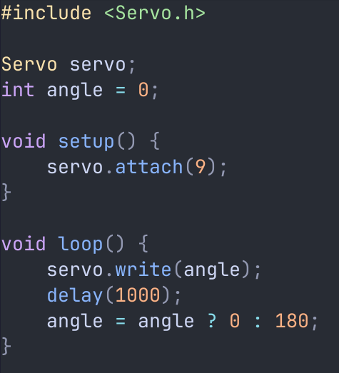
Servos

Slide 30
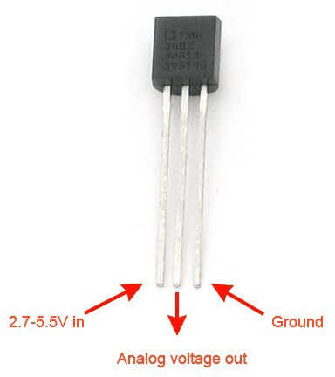
TMP36 sensor

Slide 31
TMP36 behaviour
The analogue output pin outputs a voltage between 0 and 5 volts (0 and 5000 millivolts)
The temperature (in °C) is:
  (Vout – 500) / 10

Slide 32
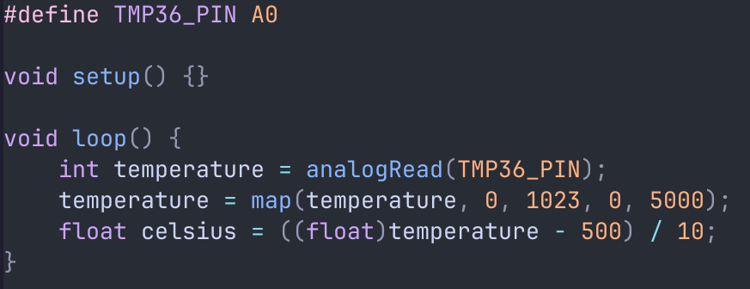
TMP36 code

Slide 33
Networking
We can’t really do this in TU Dublin

Slide 34
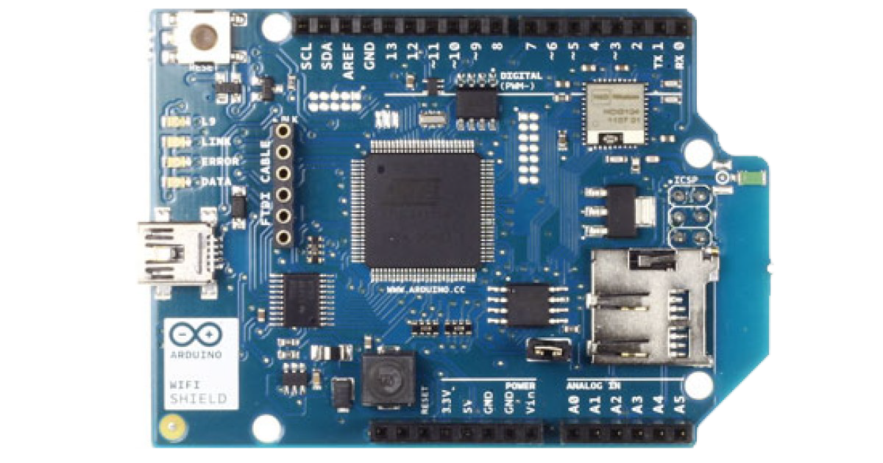
Networking shield

Slide 35
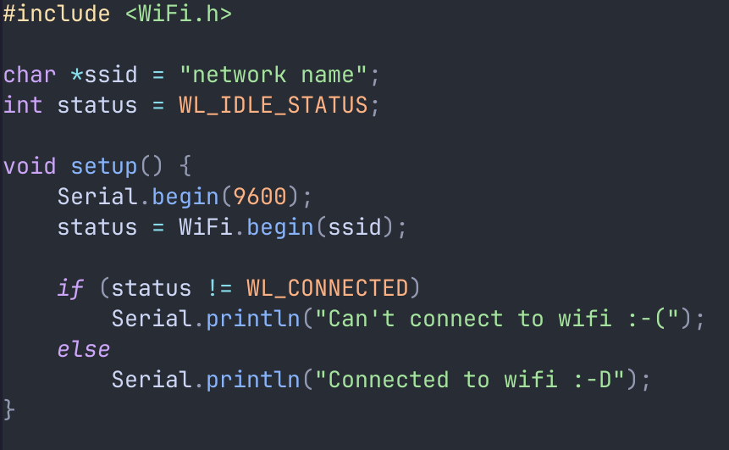
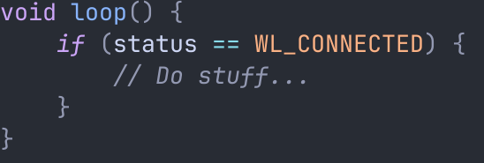
Connecting to WiFi

Slide 36
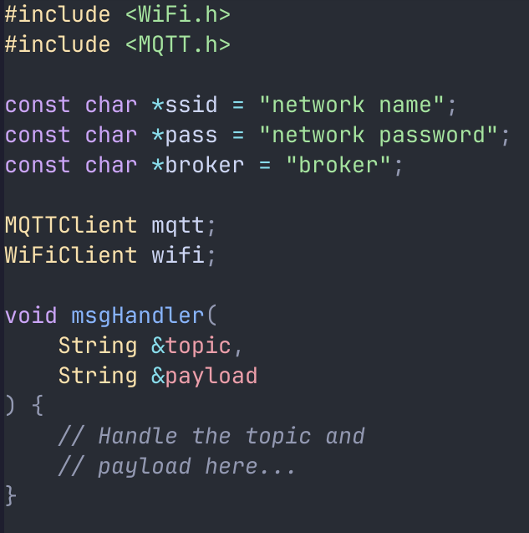
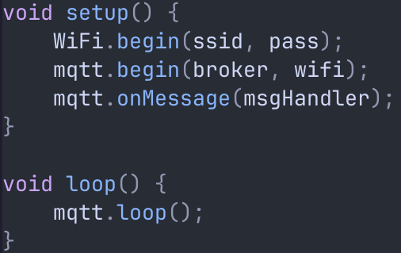
MQTT subscriber

Slide 37
Summary
Introduced the Arduino and its programming model
Provided a number of examples of Arduino sketches
Described the TMP36 temperature sensor
Gave a basic outline of the Arduino networking API

Slide 38
<number>
That’s all for this week
Thanks for your attention!

